Slide 1

CloudAI
About the course

Slide 2
About me
A teacher at Thomas More since 2009
Has taught at some point:
Windows Server (Active Directory)
PowerShell
Networking essentials
IoT essentials
SQL
Programming essentials
Data Science
Deep learning
Articifial intelligence

Slide 3
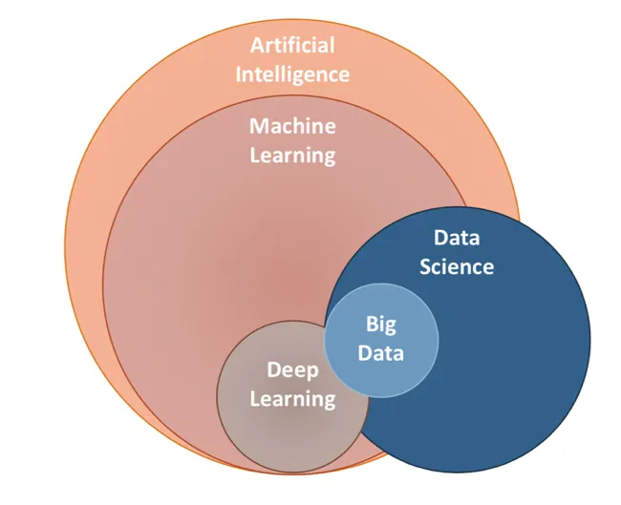
Course goals
Data science: course in 2ITF
AI: course in 2ITF
Machine learning: focus of this course (AI on structured data, but we’ll be doing more than just that)
Deep learning: Big Data course in 3ITF
Notes:
https://ai.plainenglish.io/data-science-vs-artificial-intelligence-vs-machine-learning-vs-deep-learning-50d3718d51e5

Slide 4

Cloud
The cloud is important
This course uses an AWS-academy course
You’ll do most of that course, joined with slides on the ‘regular’ canvas course
When studying:
Start from the Thomas More-slides
Do the AWS-course as mentioned
The goal of using AWS is to get to know Sagemaker and S3 buckets

Slide 5
Course layout
10 weeks:
2 on campus blocks: theory, discussion topics, exercises
The project:
Do AI and advanced data science on a basic dataset (pass/fail) and on an elaborate dataset (excelling)
Do time series forecasting on a third dataset (pass/fail and excelling)
The exam:
Presentation of the project (in group)
Individual oral questions on the theoretical contents of the course
During the semester (not in January)

Slide 6
The exam
Project deadline: Thursday 28-nov-2024
Upload al the files
Two weeks following that: presentations
Oral exam
As questions during the presentation
Deep dive into theoretical concepts
See the discussion topics for inspiration
Grading: 65% project, 35% theoretical concepts

Slide 7
The classes
We have 2 blocks on campus
Presentations and examples
Time for exercises and discussion topics
You should spend time on this course during the week
This course will be done by 16-Dec, but you should still ‘earn’ your credits
And since you won’t be studying for this course in January (during the exams) you should expect to work on it in September, October and November
Most of the grading comes from a group project, so set up a weekly moment to work on the project in team!
It helps to know you’re not alone

Slide 8
About the slides
The central guideline in this course
Refers to AWS-course or other external
Not numbered per class (week 1 is not necessarily ppt 1)
Sparsely formatted on purpose
You may apply a theme for yourself
Not a good example for your final presentation
Your final presentation: sell yourself (or your project) to a jury
These presentations: course material, not selling anything
Don’t forget the notes, sometimes they contain more information or useful links
Notes:
I mean these notes down here.

Slide 9
About the slides
Powerpoint is supercalifragilisticexpialidocious, but it has its limits
Sometimes the slide will be a link
To a jupyter notebook with explanations
To a jupyter notebook with an exercise
To a markdown-file with explanations
To the module on AWS
…
The slides are the guide between all the other course material, but are not the only course material

Slide 10
What we’ll be doing
Modules on AWS
Contain course material and exercises
But the exercises are easy (just run the code, sometimes type some code)
Discussion topics
Basis for oral part of examination
Tries to get you to reflect on the course material (AWS and PPT)
To be discussed in your project-team
Exercises
To be done on Sagemaker or locally
Individual, but may be discussed in your project team
Not real “exercises,” more guidelines
Can generally be done in under 10 minutes, but shouldn’t

Slide 11


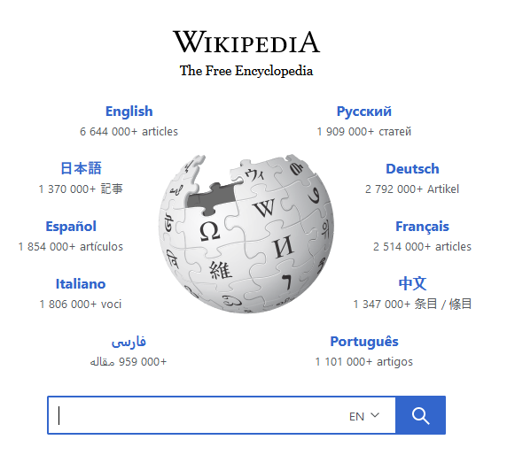
Notes:
Book was very thrilling, so much so I couldn’t sleep anymore. This was a problem.
I could look up the ending of the book Wikipedia. That would have helped me sleep, but I’d have to find a new book to read (preferably a boring one).
The moral of the story: I didn’t look up the ending (yet) and decided that all solutions to the exercises will be available from the very beginning of the course. You can simply read them and say ‘Yeah, I could have thought of that’ or not and actually learn something. Your call.
Update: In the end I did look up the ending, and I’m glad I did.

Slide 12

Using AI
The past years there have been many advancements in code- and text-generating AI
This is however a programming course, so you are very explicitly not allowed to use any of that sort of nonsense
Also don’t use stack overflow, as it helps to much

Slide 13
Using AI
You can use all the copilot and Stackoverflow and ChatGPT you like
Also to generate text in your report, but remember you are not graded by number of words
A good 10-page report will always be better than a 50-page report with a lot of nonsense in it
Do remember to list the AI’s you used as sources when submitting
Also in or below code blocks
These PowerPoints will never focus on “how to program this,” as we assume you can figure that one out yourself
Unlike Python in 1 ITF
But make sure you understand all the code you submit
You must be able to explain any of the code you used

Slide 14
The project
Use a toy dataset and an actual dataset
Toy dataset: Titanic
Actual dataset 1: UK housing
Actual dataset 2: Stock prices
For dataset 2: scrape the data
Using a webscraper, an api, a CSV-download, …
Do data science
Clean and explore
Do machine learning
Compare models and predict

Slide 15
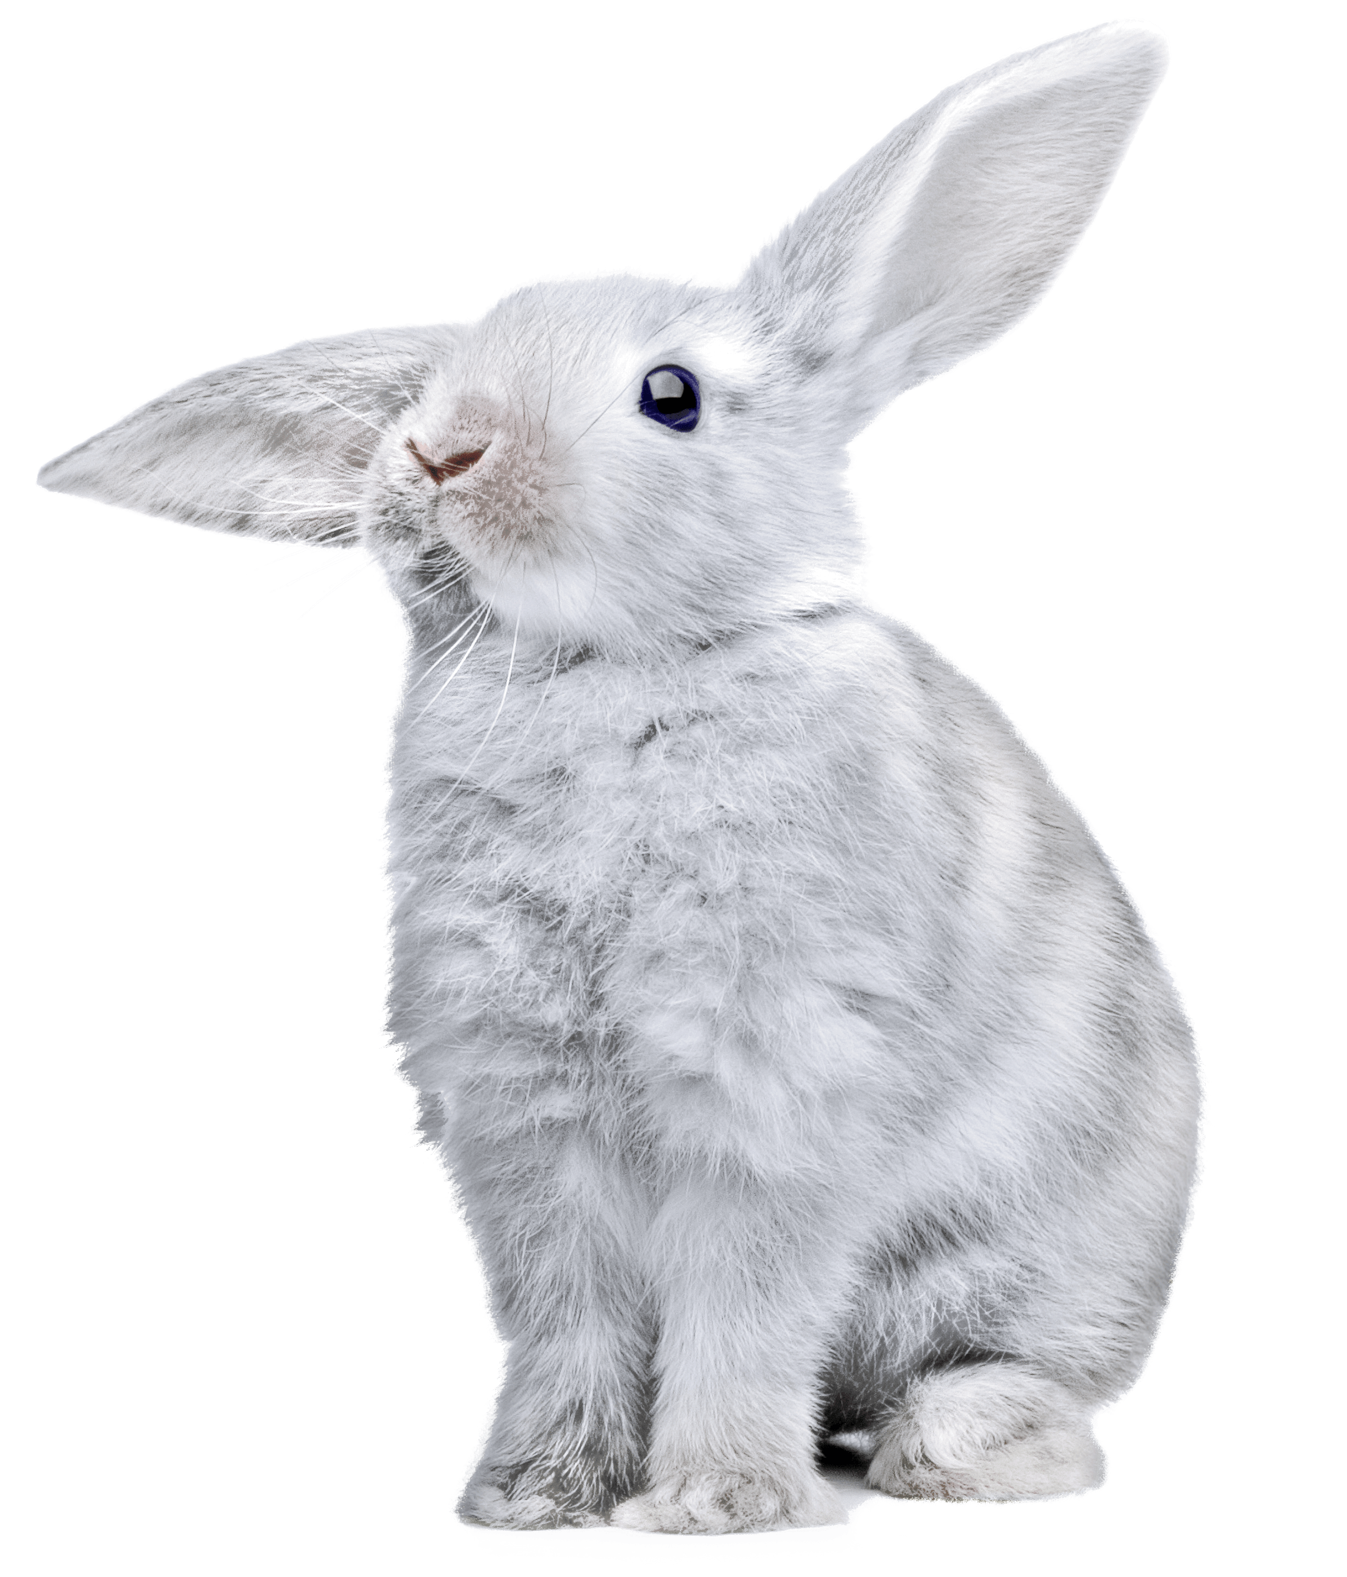
The first class
Presentation on Weapons of Math Destruction
AWS
Login
Find the correct course (Machine Learning Foundations, 3790)
Finish module one (hello world of modules)
Group
Make a group
Create a github repo, invite me
Do the first discussion topics
And the Lord spoke, saying, "First shalt thou take out the Holy Pin. Then shalt thou count to three, no more, no less. Three shall be the number thou shalt count, and the number of the counting shall be three. Four shalt thou not count, neither count thou two, excepting that thou then proceed to three. Five is right out.”
Notes:
The quote: https://en.wikiquote.org/wiki/Monty_Python_and_the_Holy_Grail

